Slide 1
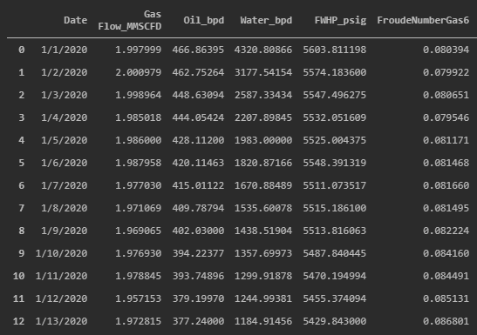
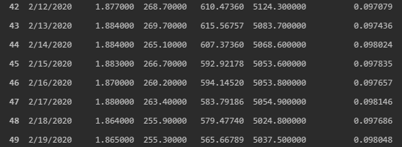
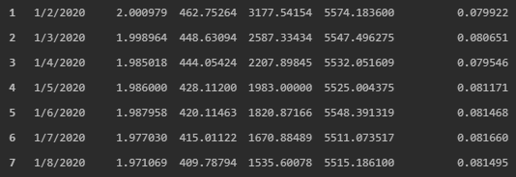
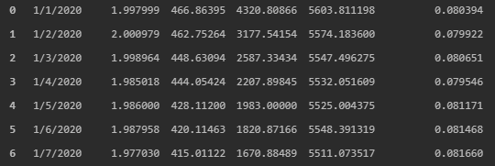

Slide 2
RNN/CNN 3-D Data
Data Frame
R0
……
R1
R2
First Sample
First 7 Targets Ignored
R3
Examples
Targets
R4
R5
R7
R6
R5
R4
R3
R2
R1
R8
R6
R7
R7
R6
R5
R4
R3
R2
R1
R0
Features
R7
Features
Sequences (Time series or Rows)

Slide 3
RNN 3-D Data
Data Frame
R0
……
R1
R2
First Sample
First 7 Targets Ignored
R3
Examples
Targets
R4
R5
R7
R6
R5
R4
R3
R2
R1
R8
R6
R7
R7
R6
R5
R4
R3
R2
R1
R0
Features
R7
Features
Sequences (Time series or Rows)

Slide 4
ConvLSTM 5-D Data Imagine: every cell of a 2-D dataframe includes a 3-D dataset
R0-6
R7-13
R14
Samples
Targets

Slide 5
Feed-Forward DNN
R0
R0
……
……
……
Features
Input Layer
Hidden Layer
Hidden Layer
Output Layer

Slide 6
RNN-Multiple Sequences to One
R0
R1
……
……
……
R2
……
……
……
R3
……
……
……
Sequences (Time series)
R4
……
……
……
R5
……
……
……
R6
……
……
……
……
……
……
Features
Input Layer
Hidden Layer
Hidden Layer
Dense Layer

Slide 7
CNN-Convolution 1D Layer
10 filters to generate 10 columns
R0
R1
Filter 1 (size 3)
R2
Second Convolution layer
R3
Sequences (Time series)
5 Rows =7-3+1
R4
R5
……
R6
……
Features

Slide 8
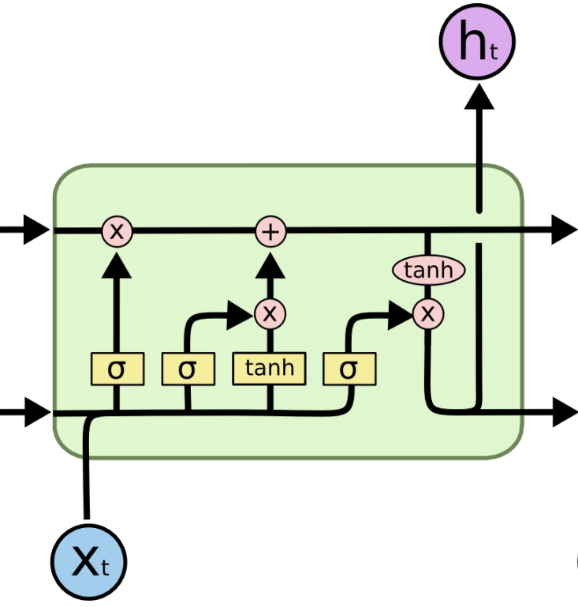


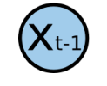

LSTM
Next Layer
Ct-1
Ct
Previous Time Step
ft
it
ot
Next Time Step

Slide 9
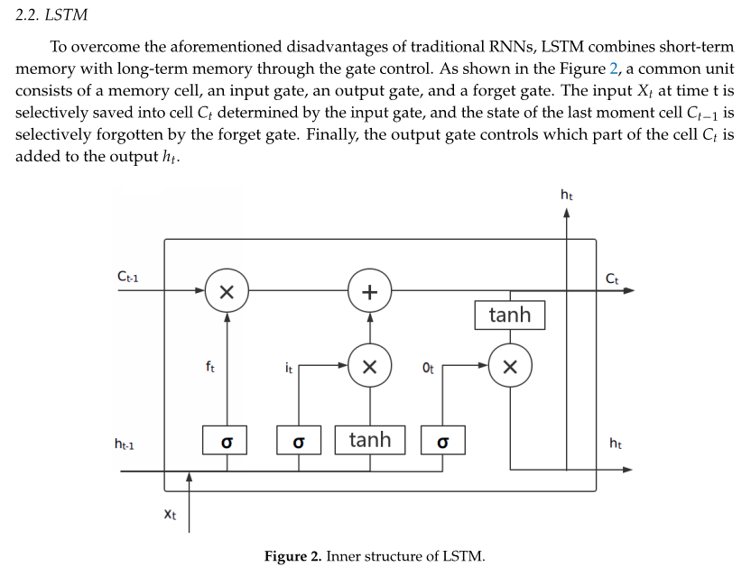

Slide 10
